Slide 1


How Russian Pro-Government Trolls Influence Online Conversations
Anton Sobolev
UT Dallas
▸ ↳ └ └
Cyber Escalation in Conflict
UCSD, Feb 2023

Slide 2
Roadmap
☐ Paid Political Commentators
┣ Motivation
┣ Definition: Troll VS Paid Troll┃Troll VS Bot
┗ Context: Authoritarian & Foreign Policy
☐ Challenges
┣ Flexibility: Strategies & Goals
┣ Accounts Identification
┣ Theorization: Intentions, Behavior
┃ Results
┗ Causality
Notes:
Things I will not talk today
Motivation
Place to the literature
Things I will talk:
Trolls as a tool: What makes them different from other tools of cyber offensive?
Digital Authoritarianism

Slide 3
Roadmap
☐ Paid Political Commentators
┣ Motivation
┣ Definition: Troll VS Paid Troll┃Troll VS Bot
┗ Context: Authoritarian & Foreign Policy
☐ Challenges
┣ Flexibility: Strategies & Goals
┣ Accounts Identification
┣ Theorization: Intentions, Behavior
┃ Results
┗ Causality
☐ Paper
┣ Data
┣ Measurement
┣ Design & Empirical Strategy
┗ Results
☐ Conclusions & Issues
┣ Threats to Identification
┣ Generalizability
┗ Further Research
Notes:
Things I will not talk today
Motivation
Place to the literature
Things I will talk:
Trolls as a tool: What makes them different from other tools of cyber offensive?
Digital Authoritarianism

Slide 4
Roadmap
☐ Paid Political Commentators
┣ Motivation
┣ Definition: Troll VS Paid Troll┃Troll VS Bot
┗ Context: Authoritarian & Foreign Policy
☐ Challenges
┣ Flexibility: Strategies & Goals
┣ Accounts Identification
┣ Theorization: Intentions, Behavior
┃ Results
┗ Causality
☐ Paper
┣ Data
┣ Measurement
┣ Design & Empirical Strategy
┗ Results
☐ Conclusions & Issues
┣ Threats to Identification
┣ Generalizability
┗ Further Research
Notes:
Things I will not talk today
Motivation
Place to the literature
Things I will talk:
Trolls as a tool: What makes them different from other tools of cyber offensive?
Digital Authoritarianism

Slide 5
1 Trolls as a Cyber Weapon
Flexibility &
Customization
☐ Levels
┣ Macro: Manipulate platform algorithms
┗ Micro: Threaten users
☐ Targets
┣ Content-makers, commentators, readers
┗ Politicians, activists, dissidents, supporters
☐ Easy to Switch Tactics
┣ Flooding, Threats, Distraction, Persuasion
┗ Mix & Match
Notes:
Things I will not talk today
Motivation
Place to the literature
Things I will talk:
Trolls as a tool: What makes them different from other tools of cyber offensive?
Digital Authoritarianism

Slide 6
1 Trolls as a Cyber Weapon
Flexibility &
Customization
☐ Levels
┣ Macro: Manipulate platform algorithms
┗ Micro: Threaten users
☐ Targets
┣ Content-makers, commentators, readers
┗ Politicians, activists, dissidents, supporters
☐ Easy to Switch Tactics
┣ Flooding, Threats, Distraction, Persuasion
┗ Mix & Match
☐ Masked Engagement
┣ Hide Troll Identity
┗ Mimic Regular Users
Notes:
Things I will not talk today
Motivation
Place to the literature
Things I will talk:
Trolls as a tool: What makes them different from other tools of cyber offensive?
Digital Authoritarianism

Slide 7
2 Evidence ⟿ Theory ⟿ Policy
Flood →
Arguments →
Imitate Extremism →
⟿ Users leave
Online
Conversation
⟿
Users switch
the topic
Disentangle?
Disentangle?
Notes:
How evidence can inform the theory

Slide 8
2 Evidence ⟿ Theory ⟿ Policy
Initial
Goals
Flood →
Arguments →
Imitate Extremism →
⟿ Users leave
Online
Conversation
⟿
Users switch
the topic
Incentives
Disentangle?
Disentangle?
Utility Function?
Notes:
How evidence can inform the theory

Slide 9
2 Evidence ⟿ Theory ⟿ Policy
Initial
Goals
Flood →
Arguments →
Imitate Extremism →
⟿ Users leave
Online
Conversation
⟿
Users switch
the topic
Incentives
Disentangle?
Disentangle?
Utility Function?
Data Insights ⟿ Theory ⟿ Mechanism ⟿ Policy
Notes:
How evidence can inform the theory

Slide 10
2 Evidence ⟿ Theory ⟿ Policy
Initial
Goals
Flood →
Arguments →
Imitate Extremism →
⟿ Users leave
Online
Conversation
⟿
Users switch
the topic
Incentives
Disentangle?
Disentangle?
Utility Function?
Data Insights ⟿ Theory ⟿ Mechanism ⟿ Policy
Notes:
How evidence can inform the theory

Slide 11
2 Evidence ⟿ Theory ⟿ Policy
This Paper
Initial
Goals
Flood →
Arguments →
Imitate Extremism →
⟿ Users leave
Online
Conversation
⟿
Users switch
the topic
Incentives
Disentangle?
Disentangle?
Utility Function?
My Goal:
Estimate the overall observed effects of troll interventions
Notes:
How evidence can inform the theory

Slide 12
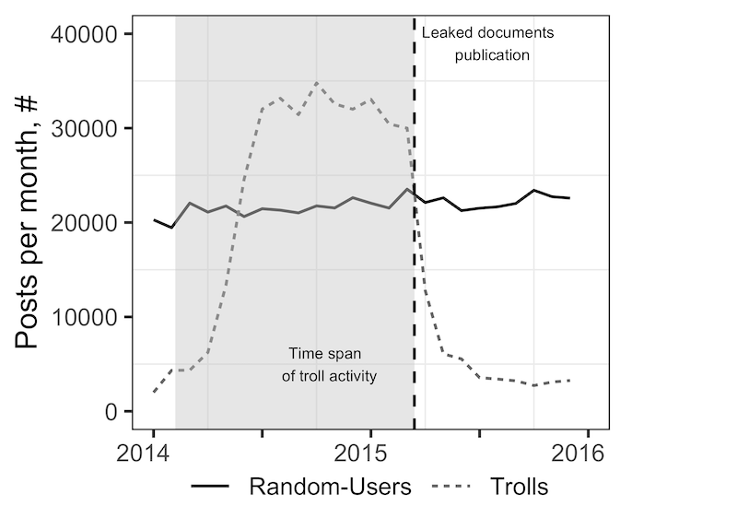
Data
☐ Troll Factory Data Leak
┣ 700 Leaked Accounts on LJ
┣ 2014-15
┗ 130k troll-infilitrated discussions
☐ Random LJ Users
┗ 4M Random Posts & Discussions
☐ Trolls’ Target
┗ Russia’s Domestic Audience
Notes:
Things I will not talk today
Motivation
Place to the literature
Things I will talk:
Trolls as a tool: What makes them different from other tools of cyber offensive?
Digital Authoritarianism

Slide 13
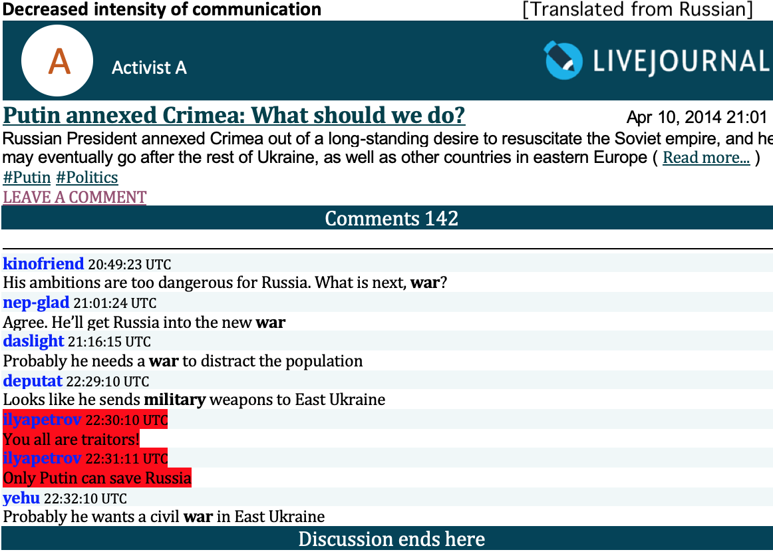

Slide 14
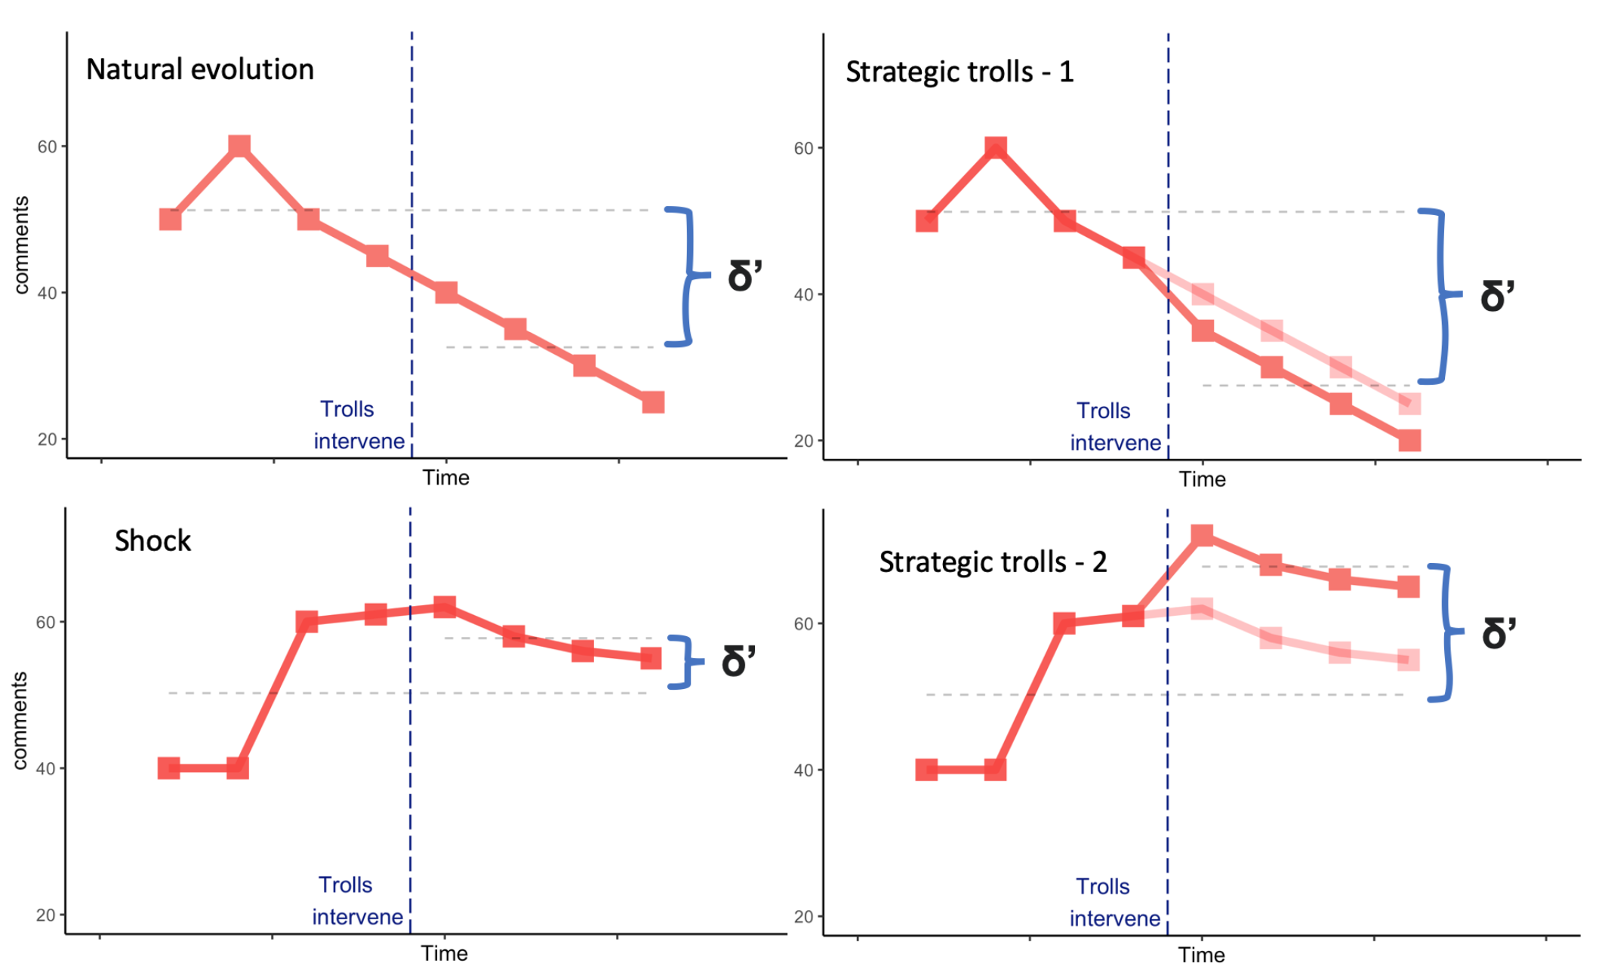
Causal Inference Challenge

Slide 15
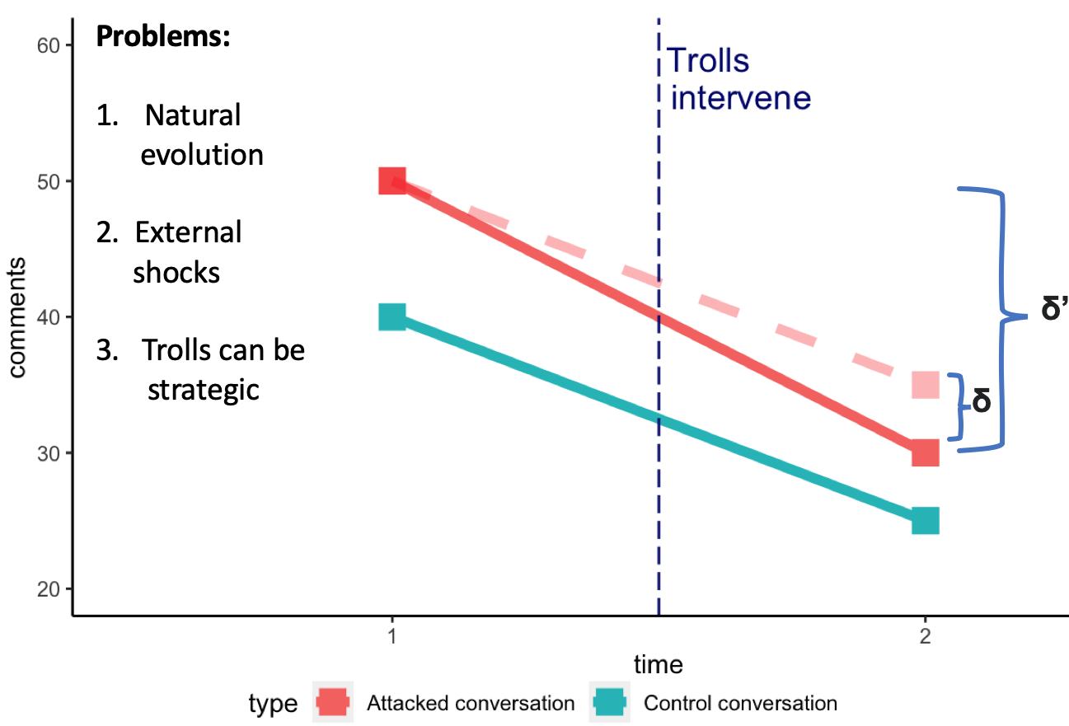
Empirical Strategy
☐ Observational Setting
┣ DiD
┗ Matching
☐ Control Conversation
┣ Discuss the same topic
┣ High chance of attack
┗ Time overlap
☐ How?
┣ Approximate DGP
┗ Simplicity of LJ Platform
Notes:
Things I will not talk today
Motivation
Place to the literature
Things I will talk:
Trolls as a tool: What makes them different from other tools of cyber offensive?
Digital Authoritarianism

Slide 16
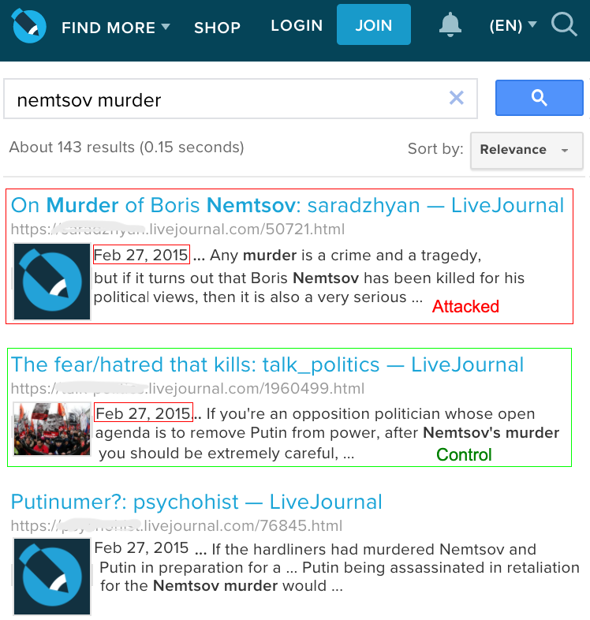
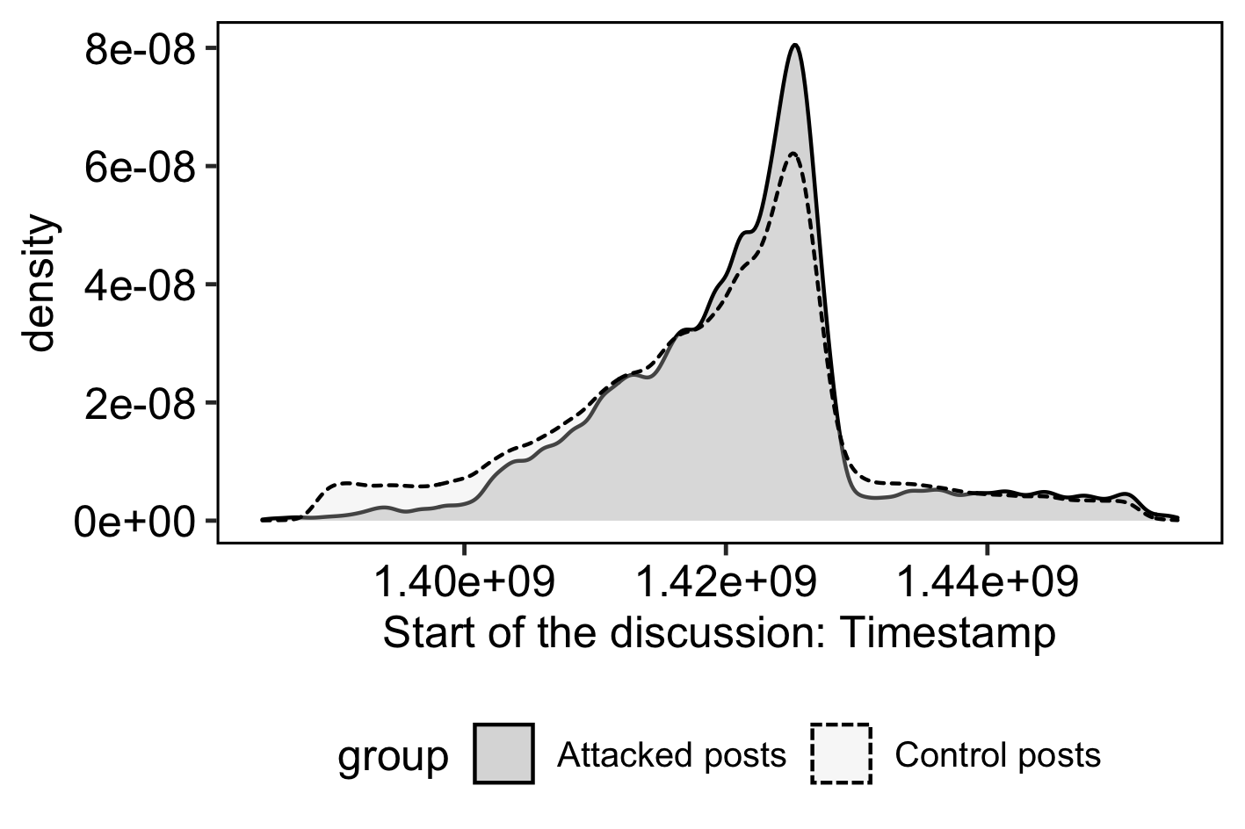
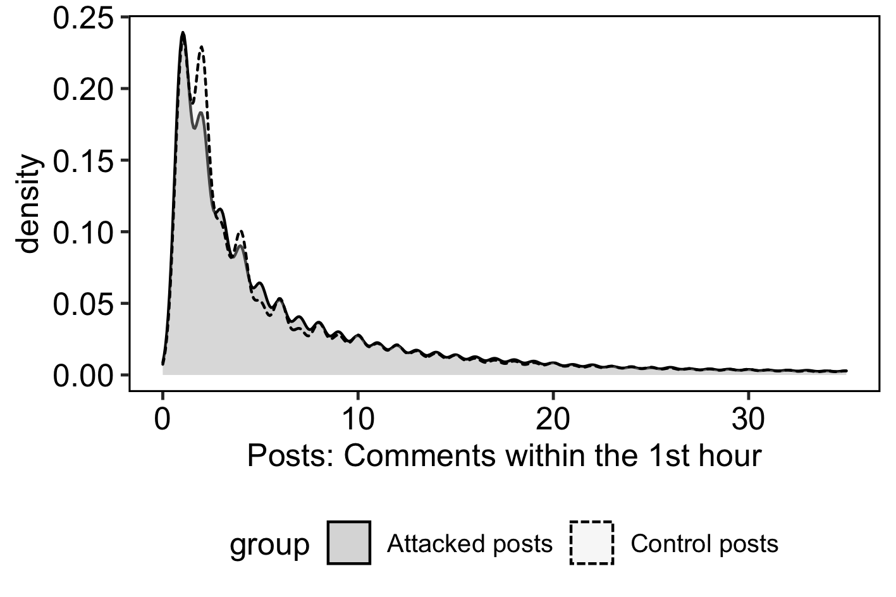
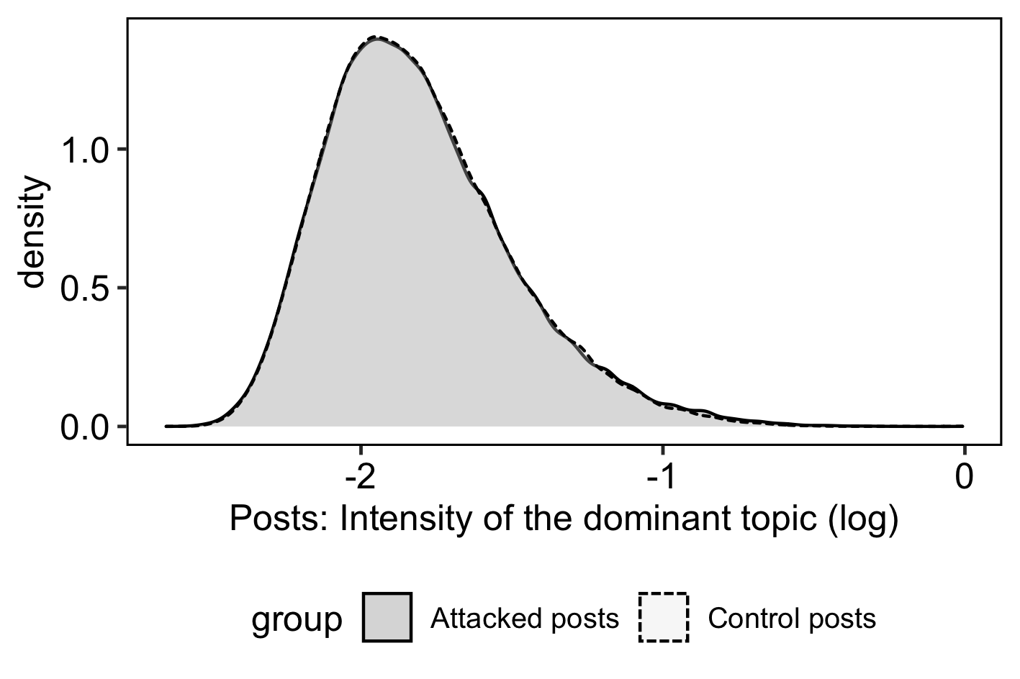
Balance

Slide 17
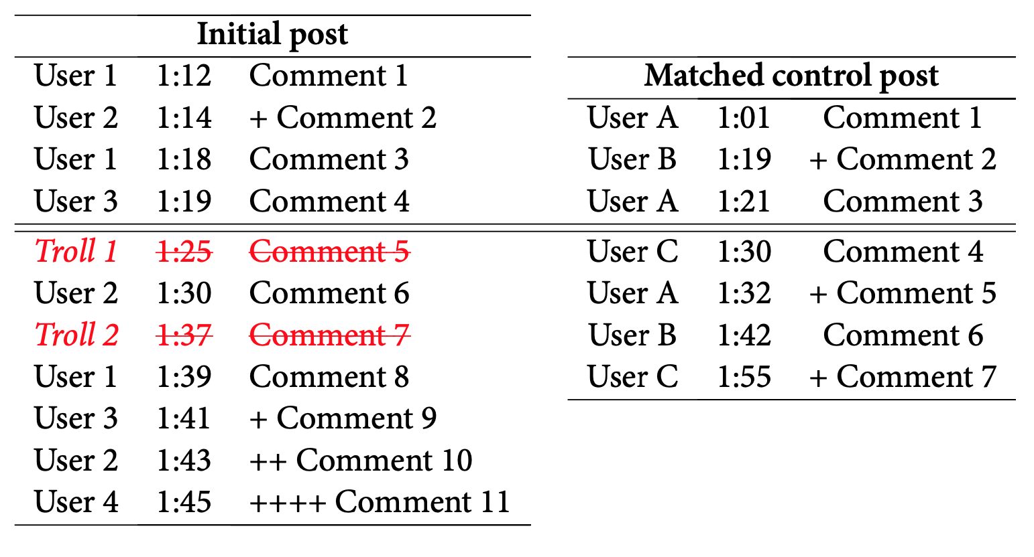

Outcomes of Interest
☐ Structural Outcomes
┣ Intensity: Comments & Threads
┗ Engagement: Users & Replies
☐ Content Outcomes
┣ Sensetive Topics
┃ Political Opposition, Economy
┃ in Crisis, War in Ukraine
┗ Agenda Promotion
NATO Aggresion
Putin’s Foreign Policy Success
Notes:
Things I will not talk today
Motivation
Place to the literature
Things I will talk:
Trolls as a tool: What makes them different from other tools of cyber offensive?
Digital Authoritarianism

Slide 18
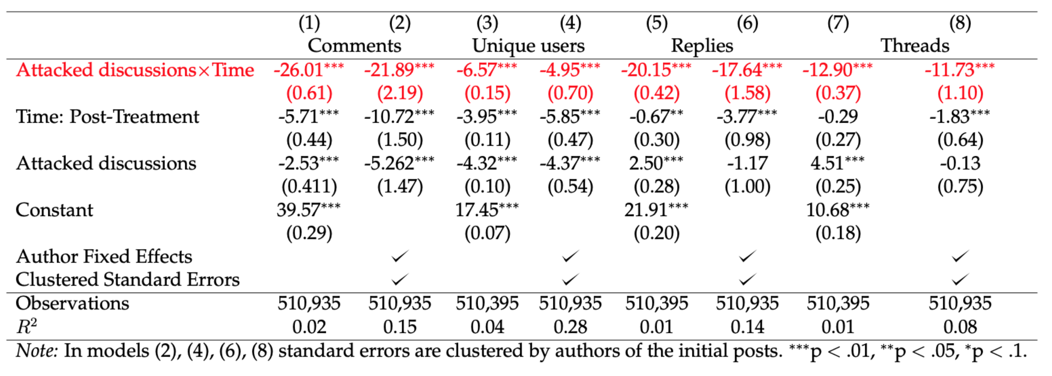
Results–1: Structural Outcomes
Notes:
Things I will not talk today
Motivation
Place to the literature
Things I will talk:
Trolls as a tool: What makes them different from other tools of cyber offensive?
Digital Authoritarianism

Slide 19
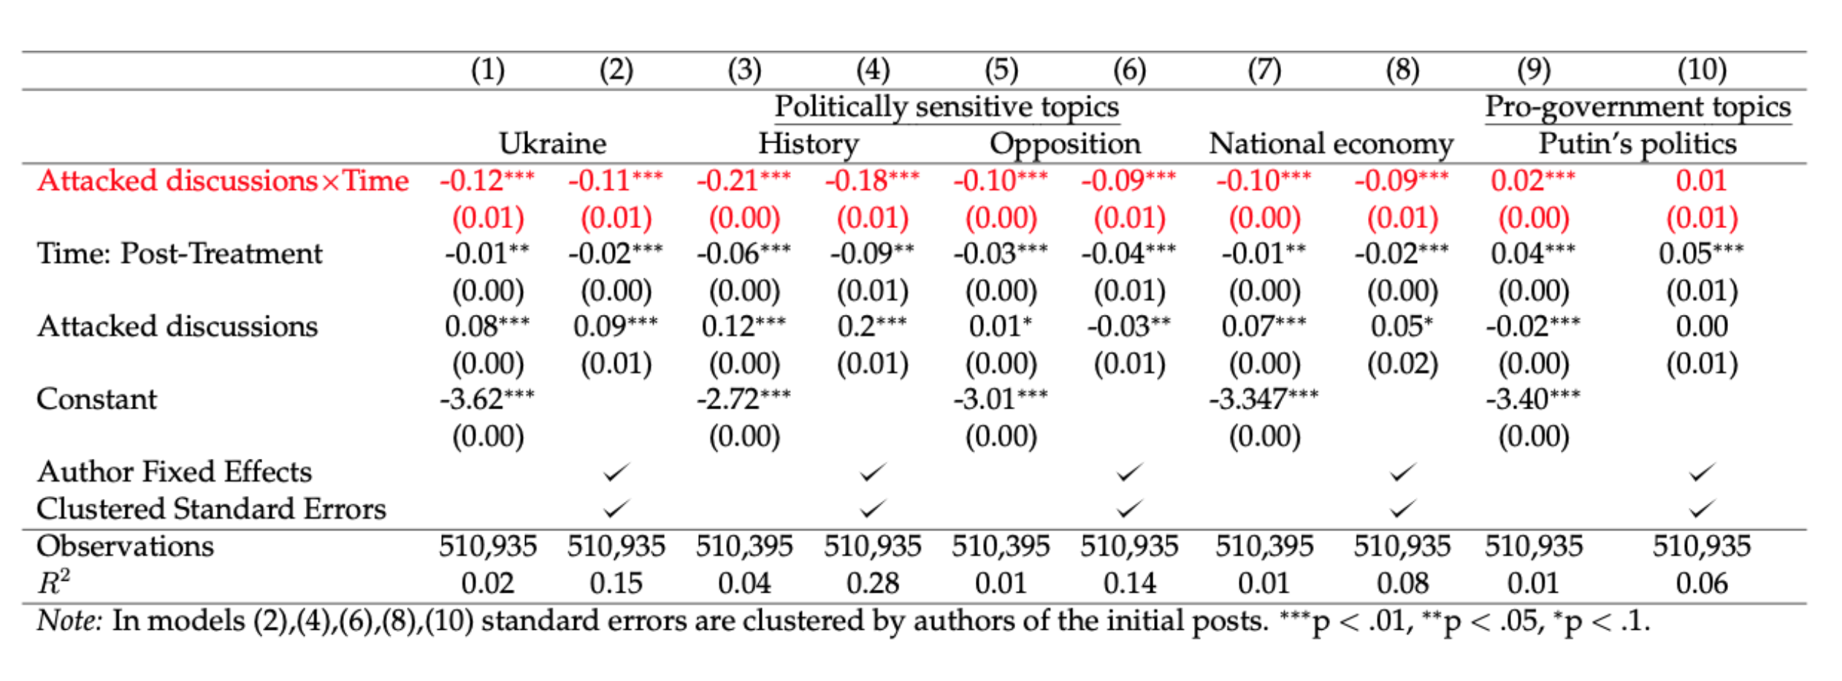
Results–2: Content Outcomes
Notes:
Things I will not talk today
Motivation
Place to the literature
Things I will talk:
Trolls as a tool: What makes them different from other tools of cyber offensive?
Digital Authoritarianism

Slide 20
Results
☐ Structural Perspective
┣ Infiltrated discussions degrade
┗ Users leave the conversation
☐ Content Perspective
┣ Distraction: Users shift away from sensitive topics
┗ Agenda Promotion: No evidence of the effect
Notes:
Things I will not talk today
Motivation
Place to the literature
Things I will talk:
Trolls as a tool: What makes them different from other tools of cyber offensive?
Digital Authoritarianism

Slide 21
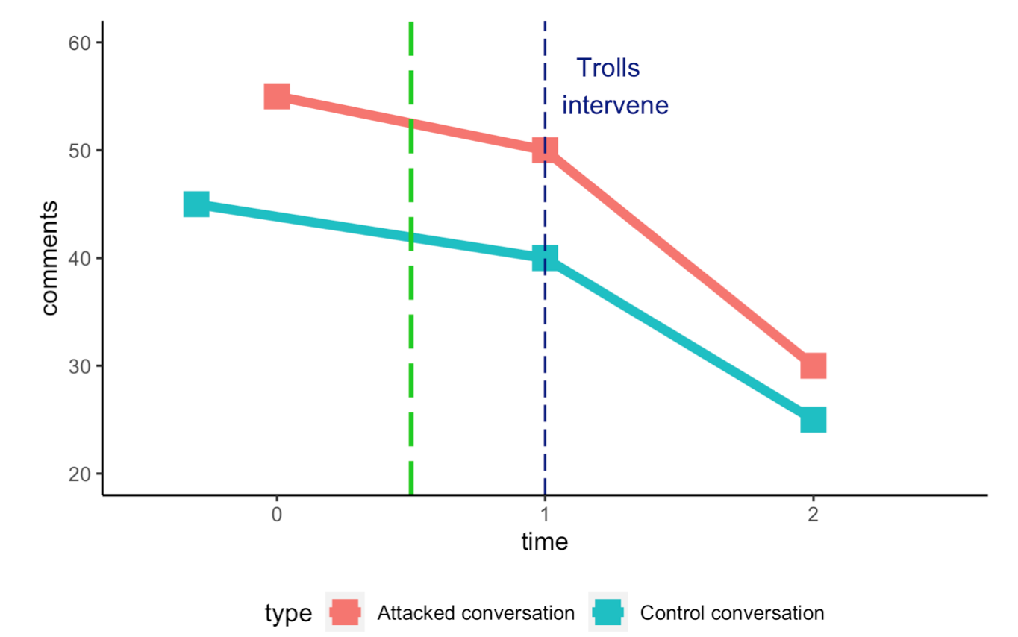
Threats to Validity
☐ Underlying parallel trends
☐ Effect of a new user
☐ Deleted comments
☐ Incomplete List of Trolls
Notes:
Things I will not talk today
Motivation
Place to the literature
Things I will talk:
Trolls as a tool: What makes them different from other tools of cyber offensive?
Digital Authoritarianism

Slide 22
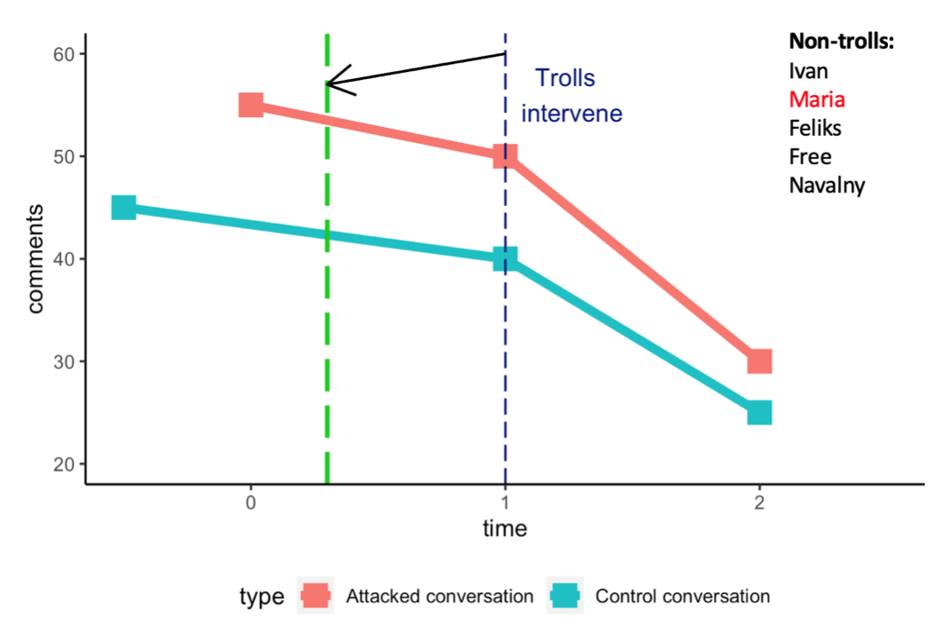
Threats to Validity
☐ Underlying parallel trends
☐ Effect of a new user
☐ Deleted comments
☐ Incomplete List of Trolls
Notes:
Things I will not talk today
Motivation
Place to the literature
Things I will talk:
Trolls as a tool: What makes them different from other tools of cyber offensive?
Digital Authoritarianism

Slide 23
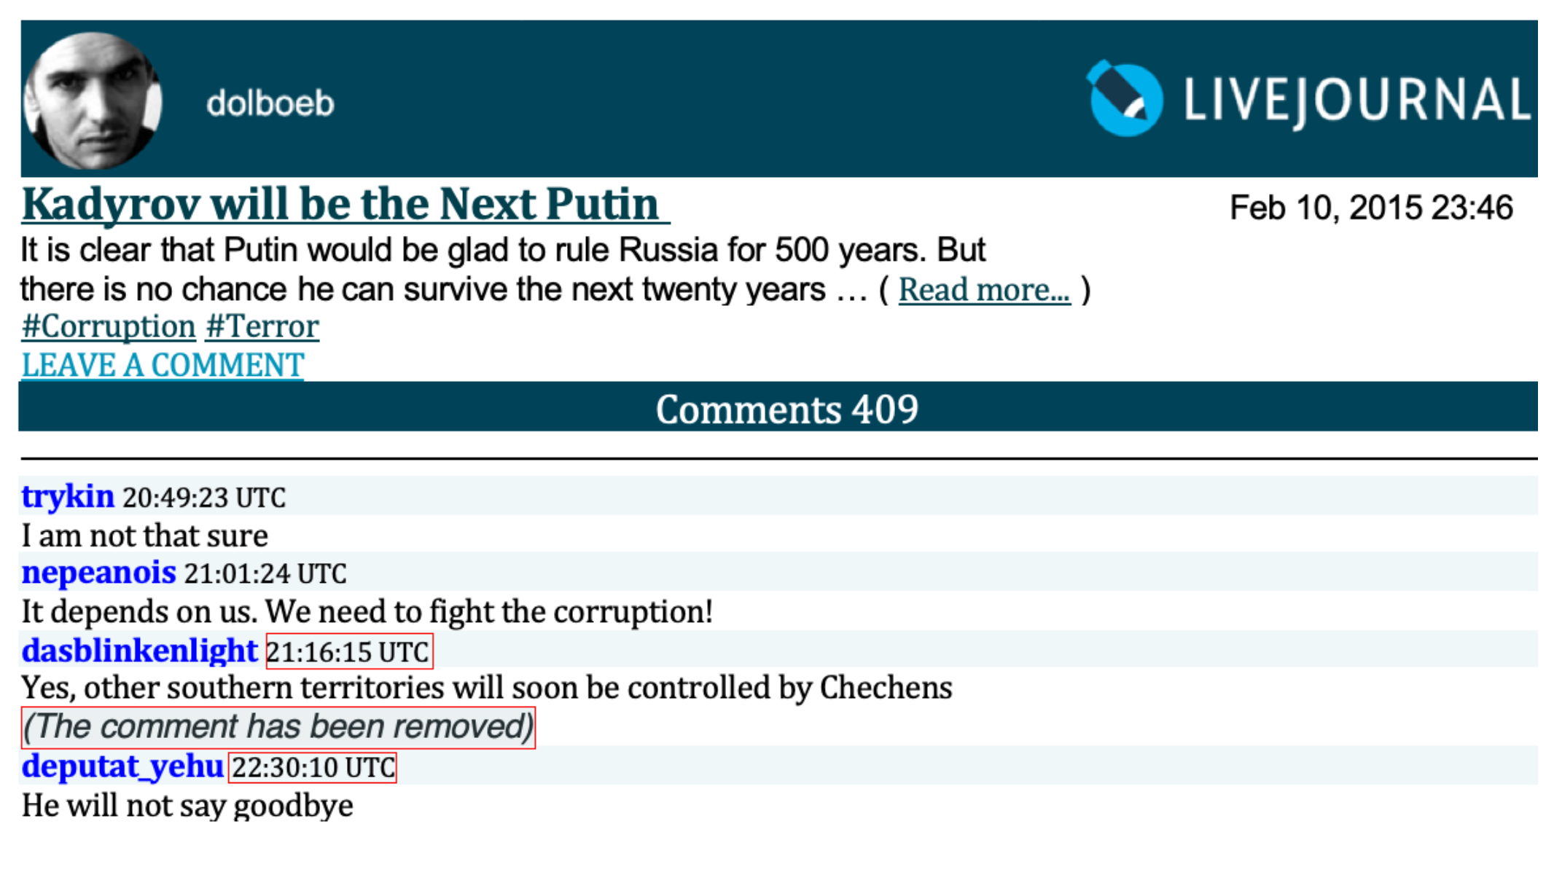
Threats to Validity
☐ Underlying parallel trends
☐ Effect of a new user
☐ Deleted comments
☐ Incomplete List of Trolls
Notes:
Things I will not talk today
Motivation
Place to the literature
Things I will talk:
Trolls as a tool: What makes them different from other tools of cyber offensive?
Digital Authoritarianism

Slide 24
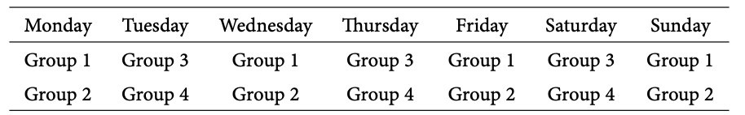
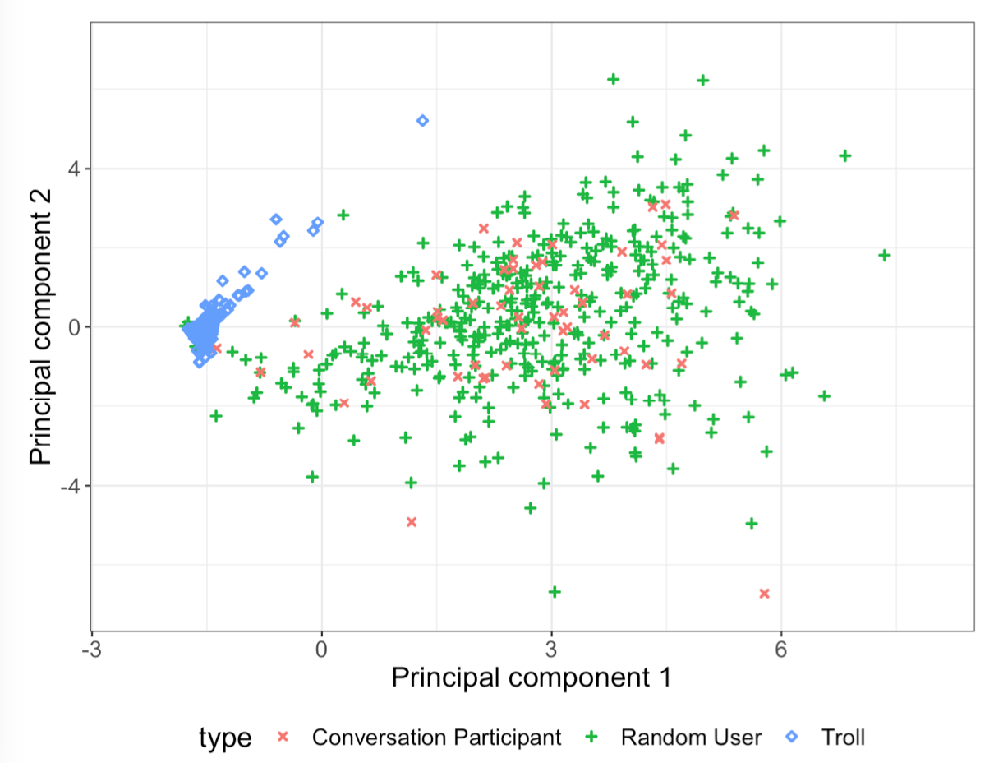
Threats to Validity
☐ Underlying parallel trends
☐ Effect of a new user
☐ Deleted comments
☐ Incomplete List of Trolls
Notes:
Things I will not talk today
Motivation
Place to the literature
Things I will talk:
Trolls as a tool: What makes them different from other tools of cyber offensive?
Digital Authoritarianism

Slide 25
Conlcusiosns
☐ Identified Effects of Troll Interventions
┣ Trolls prevent political communication
┗ No evidence on promotion of pro-government agenda
☐ Generalizability
┣ LJ: Common Social Media Platform
┗ Facebook, Instagram, VK
☐ Approximation of DGP
┣ Specifics of the Сyberspace
┗ Simplicity of LJ platform engine
Notes:
Things I will not talk today
Motivation
Place to the literature
Things I will talk:
Trolls as a tool: What makes them different from other tools of cyber offensive?
Digital Authoritarianism

Slide 26
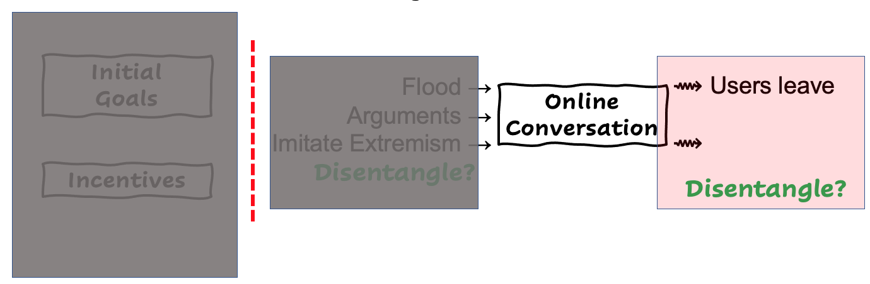
Conlcusiosns
☐ Identified Effects of Troll Interventions
┣ Trolls prevent political communication
┗ No evidence on promotion of pro-government agenda
☐ Generalizability
┣ LJ: Common Social Media Platform
┗ Facebook, Instagram, VK
☐ Approximation of DGP
┣ Specifics of the Сyberspace
┗ Simplicity of LJ platform engine
Notes:
Things I will not talk today
Motivation
Place to the literature
Things I will talk:
Trolls as a tool: What makes them different from other tools of cyber offensive?
Digital Authoritarianism

Slide 27

Conlcusiosns
THANK
YOU!
☐ Identified Effects of Troll Interventions
┣ Trolls prevent political communication
┗ No evidence on promotion of pro-government agenda
☐ Generalizability
┣ LJ: Common Social Media Platform
┗ Facebook, Instagram, VK
☐ Approximation of DGP
┣ Specifics of the Сyberspace
┗ Simplicity of LJ platform engine
Notes:
Things I will not talk today
Motivation
Place to the literature
Things I will talk:
Trolls as a tool: What makes them different from other tools of cyber offensive?
Digital Authoritarianism

